Slide 1

A Project Proposal Presentation on
KeyDash
Research Management Cell
POKHARA ENGINEERING COLLEGE
Phirke, Pokhara-8
(FEB,2026)
Submitted by:
Britant Shrestha
Manish Shrestha
Rijan Shrestha
Ranjana Dhakal

Slide 2
INTRODUCTION
In today's digital age, typing speed, accuracy, adaptability across languages and coding are essential skills for students, professionals, and casual users alike.
"KeyDash" is a web-based application designed to evaluate typing speed in words per minute (WPM) and accuracy while providing a user-friendly interface.
It offers real-time feedback on typing speed (WPM), symbol mastery, gamification elements like streaks and social media sharing.
The project utilizes modern web technologies like HTML, Tailwindcss, JavaScript, and React.js to create an interactive and responsive tool.

Slide 3
OBJECTIVES
The primary objectives of KeyDash are:
To develop a modern, responsive applications with multi-language typing, coding practice, symbol typing, multiplayer and AI-based typing battles.
To provide real-time evaluation including WPM, accuracy, achievements, leaderboards, and progress tracking.
To enhance user motivation and continuous typing skill improvement through competitive features.
To use GitHub for version control and collaborative development.

Slide 4
LITERATURE REVIEW
Rogers and Monsell (1995) discovered that increased typing speeds minimize task completion time in computer-based processes.
Karat et al. (1999) found that better accuracy reduces cognitive strain, allowing users to focus on content rather than mechanics.
More recent research (Chen et al., 2021) emphasizes the relevance of adaptive feedback in increasing skill development, which KeyDash aims to incorporate.
KeyDash bridges these research gaps by incorporating real-time analytics, gamification, multiplayer interaction, and AI-based typing features.

Slide 5
PROBLEM STATEMENT
While typing is a fundamental digital skill in today's world, existing typing practice solutions suffer from critical limitations and outdated design.
Many platforms do not offer real-time multiplayer typing races or AI-based typing battles, which limits competitive learning, user interaction.
They lack advanced features that are crucial for comprehensive development such as multi-language support, coding practice and mastery of symbols.
Most applications do not offer integration with platforms like GitHub for version control and collaboration.

Slide 6
METHODOLOGY
Agile Development: Iterative sprints with GitHub for task tracking.
Tech Stack:
  Frontend: React.js (hooks, components), Tailwindcss for styling.
  Version Control: GitHub (branches, pull requests).
  Saving system: Supabase

Slide 7
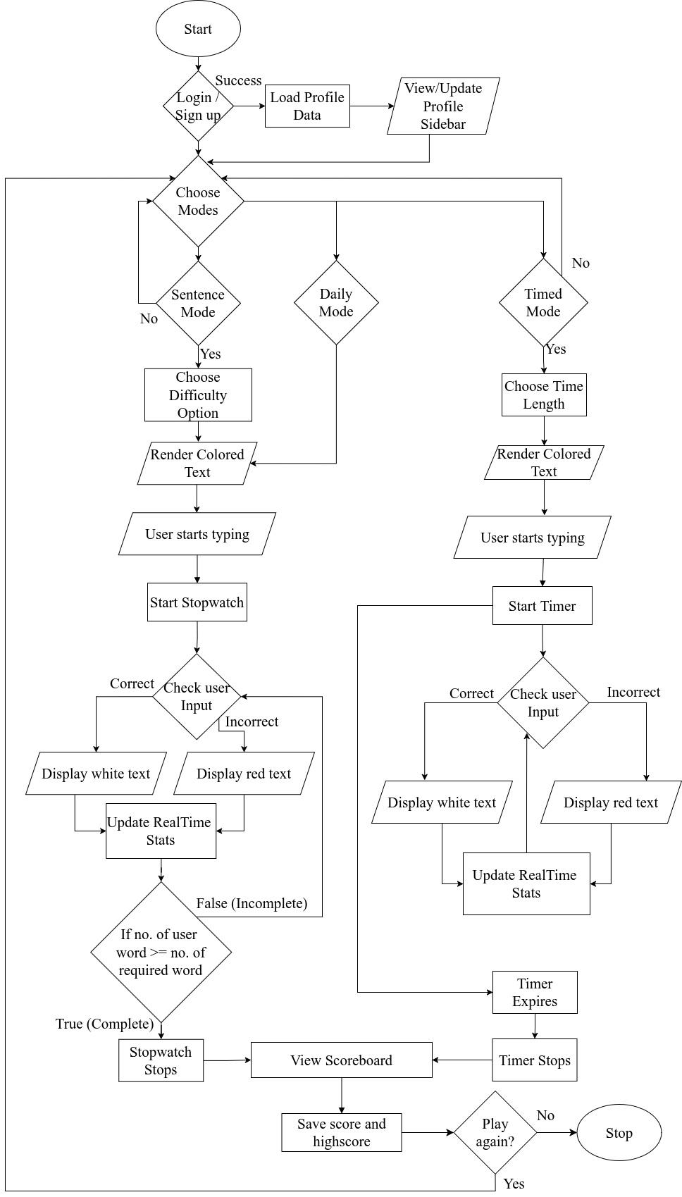
FLOWCHART:

Slide 8
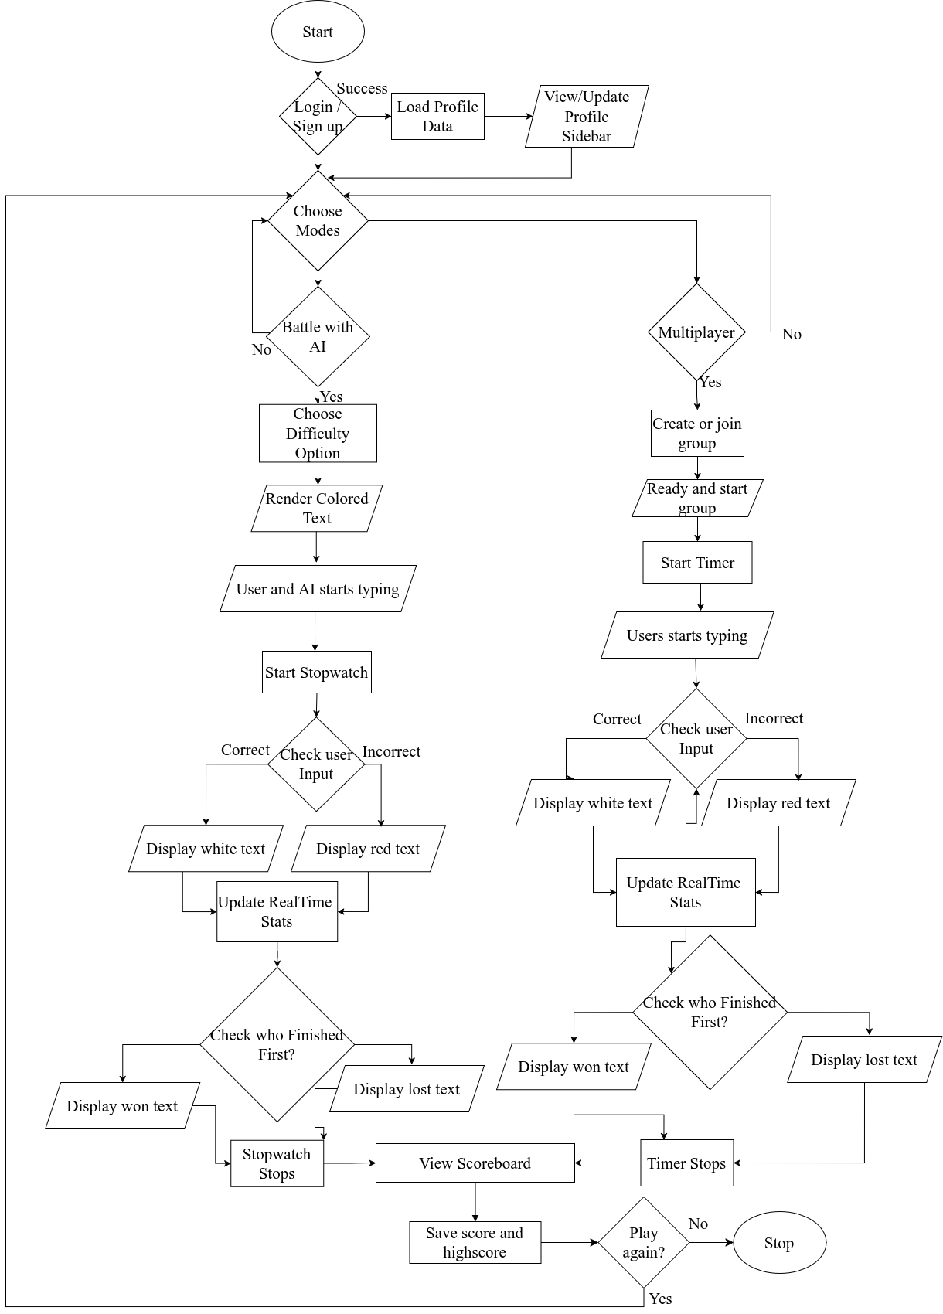
FLOWCHART:

Slide 9
TOOLS
Tools / Technology | Purpose
HTML | Structure and semantic markup of web pages
Tailwindcss | Utility-first CSS framework for styling
React.js | JavaScript library for building user interfaces
VS Code | Code editor with extensions for development
Git | Version control system
Github | Remote repository hosting
Figma | UI/UX design and prototyping
Supabase | Score saving system.

Slide 10
PROJECT SCHEDULE
Task | Week 1 | Week 2 | Week 3 | Week 4 | Week 5 | Week 6 | Week 7
Research & Planning
UI Design
Core Functionality
Testing & Debugging
Final Documentation

Slide 11
EXPECTED RESULTS
Typing Performance Metrics: Accurately measure users’ typing speed (WPM) and error rates with real-time feedback.
Web -based typing application with multilingual support, multiplayer races, and AI-based typing battles, daily streaks and social media sharing.
To enable progress tracking through saved typing history, performance analytics, and personalized insights.

Slide 12
REFERENCES
10FastFingers: Website: https://10fastfingers.com
Typeshala: Website: http://typeshala.shresthasushil.com.np/
Rogers, R. D., & Monsell, S. (1995). Costs of a predictable switch between simple cognitive tasks. Journal of Experimental Psychology: General, 124(2), 207–231.
Chen, Y., Chen, Y., & Huang, Y. (2021). Adaptive feedback systems and their impact on learning performance: A meta-analysis. Computers & Education, 174, 104309.
Zhang, L., & Sun, T. (2023). Real-time feedback systems in typing tutors: A WebSocket-based approach. Journal of Educational Technology & Society, *26*(1), 89-102.

Slide 13
THANK YOU

